Slide 1
Module-4
(Linker and Loader)

Slide 2
Contents
Basic Loader functions - Design of absolute loader
Simple bootstrap Loader
Machine dependent loader features-
Relocation
Program Linking algorithm and data structures of First pass of two pass Linking Loader
Program Linking algorithm and data structures of Second pass of two pass Linking Loader

Slide 3
Contents
Machine independent loader feature -
Automatic library search
Loader options
Loader Design Option-
Linking Loader
Linkage Editor
Dynamic Linking

Slide 4
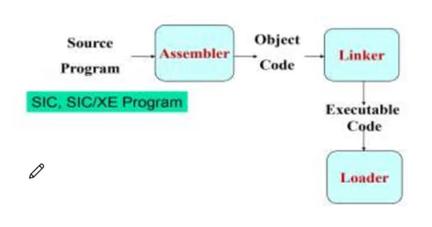
Loaders and Linkers
Memory

Slide 5
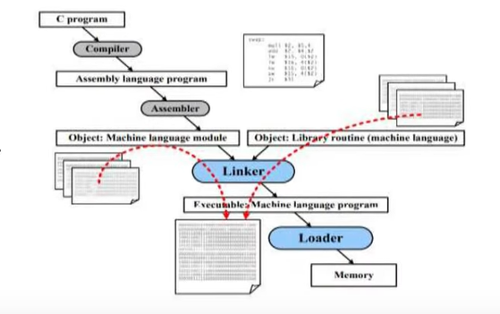
Loaders and Linkers

Slide 6
Introduction-Basic Loader functions
To execute an object program, we needs
Relocation, which modifies the object program so that it can be loaded at an address different from the location originally specified
Linking, which combines two or more separate object programs and supplies the information needed to allow references between them
Loading and Allocation, which allocates memory location and brings the object program into memory for execution

Slide 7
Basic loader function
loader is a system program that performs loading function
To bring an object program to memory and start its execution

Slide 8
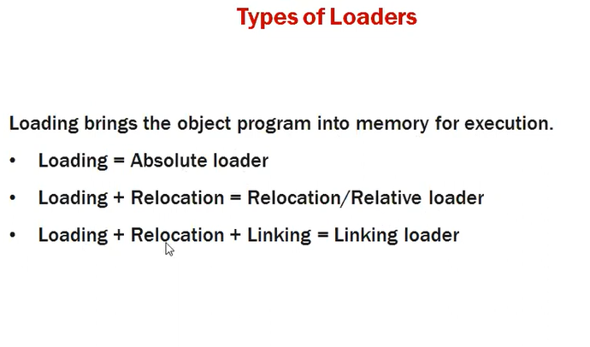

Slide 9
Design of an Absolute Loader
An absolute loader is a loader that places absolute code into main memory beginning with the initial address(absolute address) assigned by the assembler.
No address manipulation is performed.
no need for relocation and linking because the program will be loaded into the location specified in the program.
All functions are done in single pass

Slide 10
For a simple absolute loader, all functions are accomplished in a single pass as follows:
The Header record of object programs is checked to verify that the correct program has been presented for loading.
As each Text record is read, the object code it contains is moved to the indicated address in memory.
When the End record is encountered, the loader jumps to the specified address to begin execution of the loaded program.

Slide 11
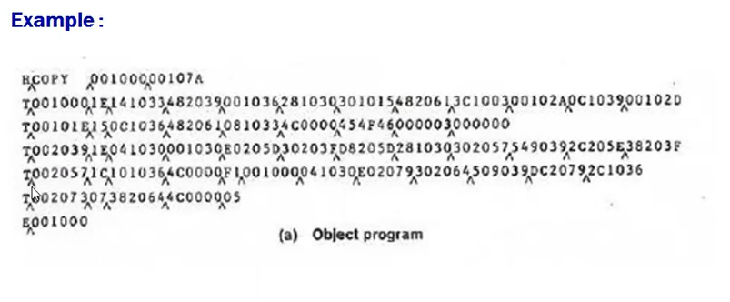

Slide 12
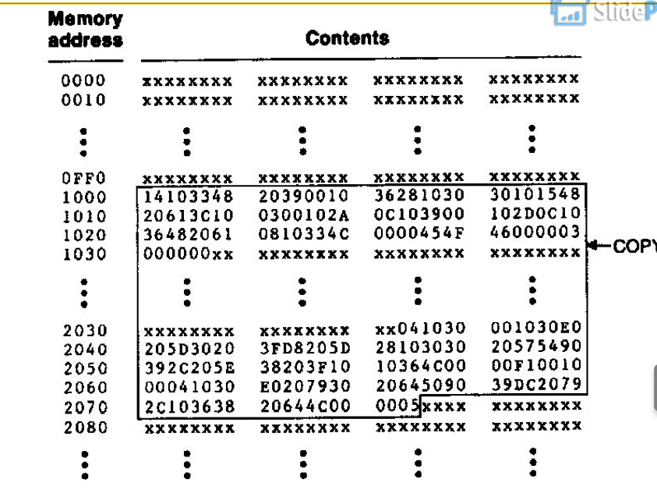
loading of absolute program

Slide 13
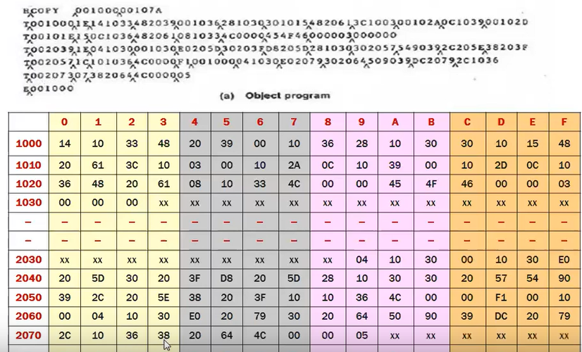

Slide 14
Fig. 3.2 Algorithm for an absolute loader
Begin
read Header record
verify program name and length
read first Text record
while record type is not ‘E’ do
begin
{if object code is in character form, convert into internal representation}
move object code to specified location in memory
read next object program record
end
jump to address specified in End record
end

Slide 15
Object Code Representation
Figure 3.1 (a)
each byte of assembled code is given using its hexadecimal representation in character form
easy to read by human beings
In general
each byte of object code is stored as a single byte
most machine store object programs in a binary form
we must be sure that our file and device conventions do not cause some of the program bytes to be interpreted as control characters

Slide 16
Advantages and disadvantages of absolute loader
The advantage of absolute loader is that it is simple and efficient, but the need for programmer to specify the actual address restricts the flexibility.
As a result we cannot run several independent programs together, sharing memory between them.
Another disadvantage is that it is difficult to use subroutine libraries while using an absolute loader
(Programmer need to remember all subroutine)

Slide 17
Simple bootstrap Loader
Given an idle computer with no program in memory, how do we get things started?
1. On some computers, an absolute loader program is permanently resident in a read-only memory (ROM). When some hardware signal occurs, the machine begins to execute this ROM program.
This is referred to as a bootstrap loader.
Bootstrap loader is an Absolute Loader
When a computer is first tuned on or restarted, a special type of absolute loader, called bootstrap loader is executed
This bootstrap loads the first program to be run by the computer -- usually an operating system

Slide 18
A Simple Bootstrap Loader
Example (SIC/XE bootstrap loader)
The bootstrap itself begins at address 0 in the memory
It loads the OS starting address 0x80
each byte of the object code to be loaded is represented on device F1
No Header record,End record or control information
the object code from F1 is loaded into consecutive bytes of memory starting from address 80.
After all the object code from device F1 is loaded the bootstrap jumps to address 80 and begin execution of the program that was loaded.

Slide 19
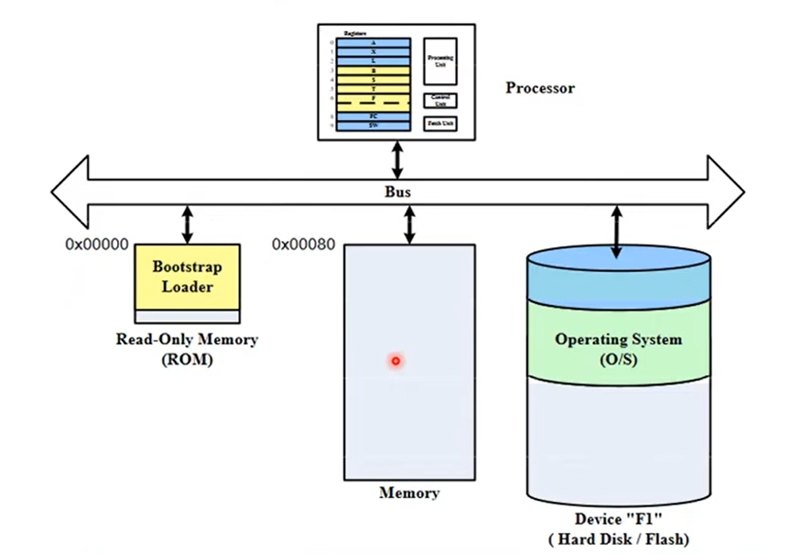

Slide 20
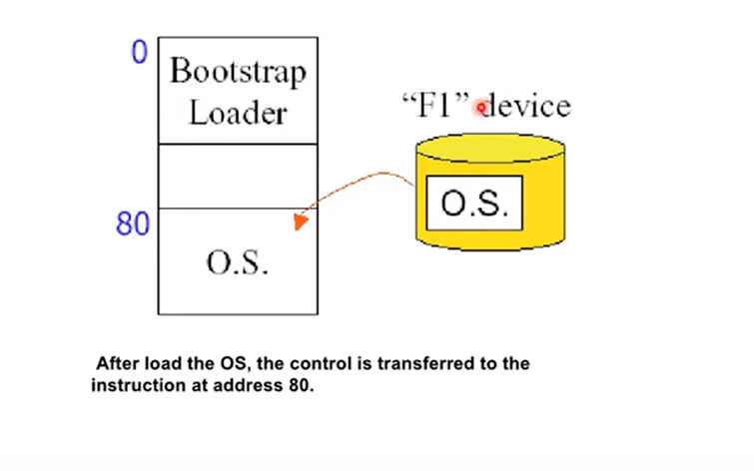

Slide 21
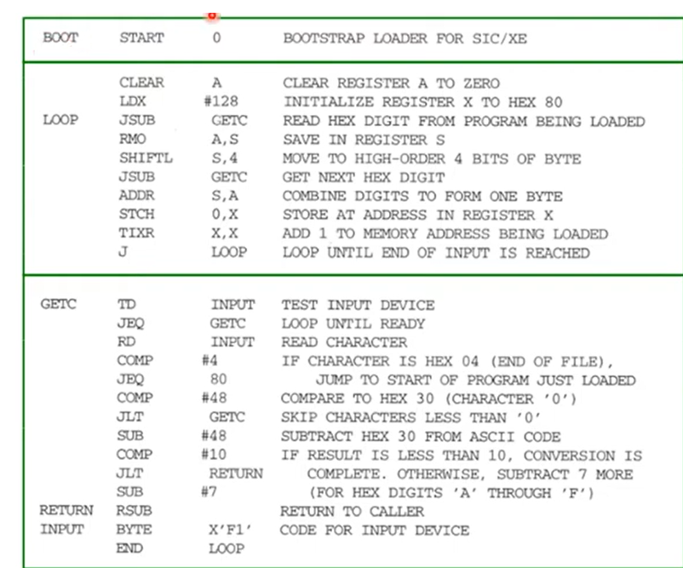

Slide 22
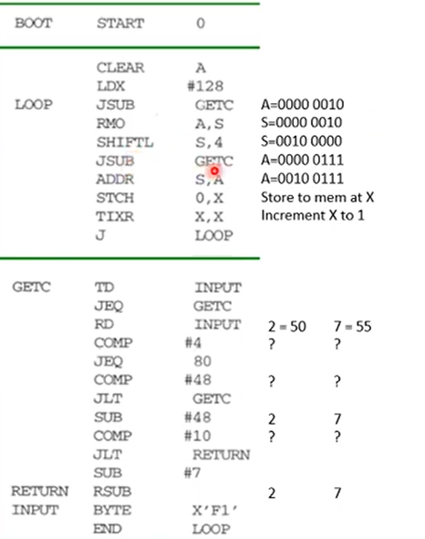
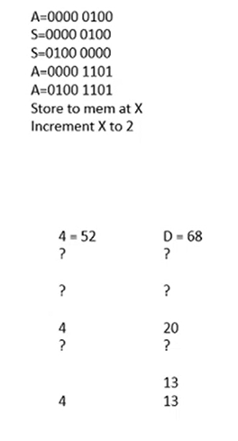
Suppose Input is 274D....

Slide 23
Fig. 3.3 SIC Bootstrap Loader Logic
Begin
X=0x80 (the address of the next memory location to be loaded
Loop
A←GETC (and convert it from the ASCII character code to the value of the hexadecimal digit)
save the value in the high-order 4 bits of S
A←GETC
combine the value to form one byte A← (A+S)
store the value (in A) to the address in register X
X←X+1
End
GETC A←read one character
if A=0x04 then jump to 0x80
if A<48 then GETC
A ← A-48 (0x30)
if A<10 then return
A ← A-7 (48+7=55)
return

Slide 24
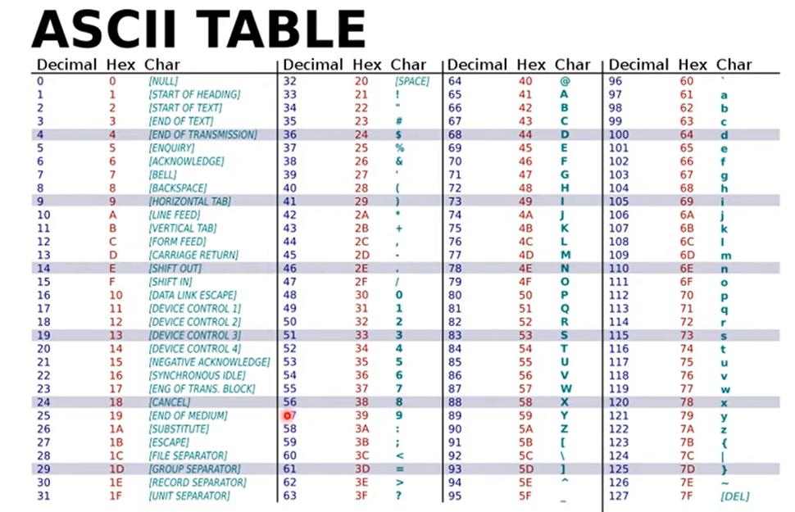

Slide 25
Machine dependent loader features-
Relocation
Program Linking algorithm and data structures of First pass of two pass Linking Loader
Program Linking algorithm and data structures of Second pass of two pass Linking Loader

Slide 26
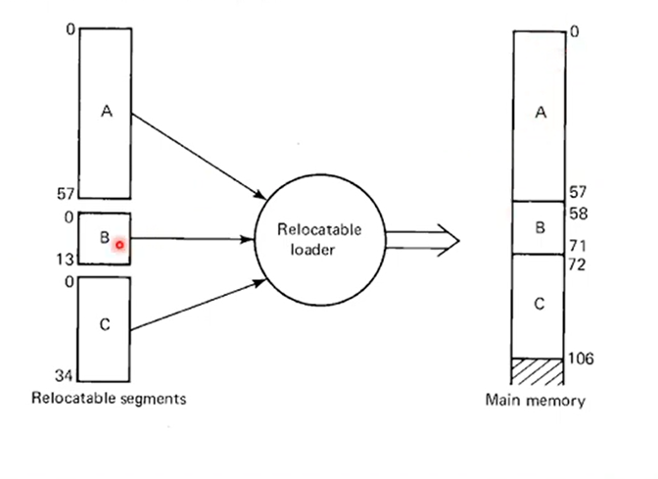
Relocation

Slide 27
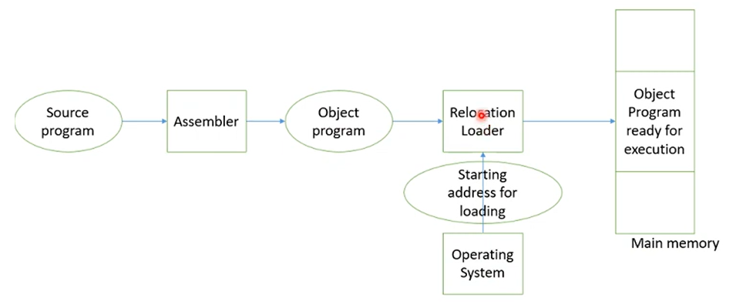

Slide 28
Relocating Loaders
Motivation
In Absolute loader programmer need to specify the actual address where program will be loaded in memory
In standard SIC with small memory no issue as only one program can be run at a time and address of that single user program is known in advance
On SIC/XE need efficient sharing of the machine with larger memory among several independent programs loading address is to be known in advance
For sharing machines need to write relocatable program instead of absolute ones
absolute loader make it difficult to use subroutine libraries(load and use only need library for efficient memory utilization)

Slide 29
Relocation
Need for program relocation indicate change to larger and powerful computer which depend on machine charecteristics.
loaders that allow for program relocation is called relocating loaders or relative loader.
Two methods for specifying relocation
modification record (for SIC/XE Fig. 3.4, 3.5)
relocation bit (for SIC Fig. 3.6, 3.7)

Slide 30
modification record (for SIC/XE Fig. 3.4, 3.5)
--Used to describe each part of the object code that must be changed when the program is relocated.
relocation bit (for SIC Fig. 3.6, 3.7)
each instruction is associated with one relocation bit
these relocation bits in a Text record is gathered into bit masks

Slide 31
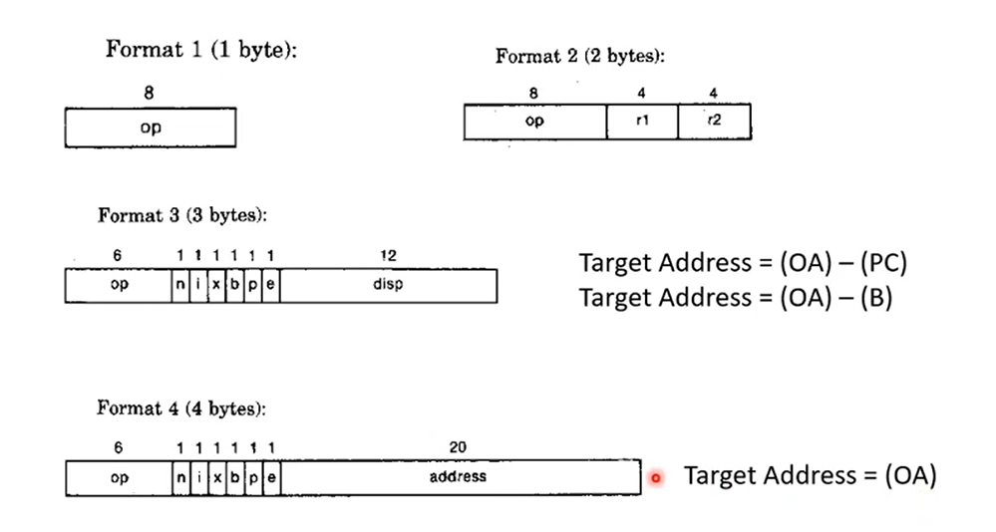
Neccessity of Relocation in SIC/XE
most of instructions use relative /immediate addressing
extended format instruction use actual address,so only these values are affected by relocation

Slide 32
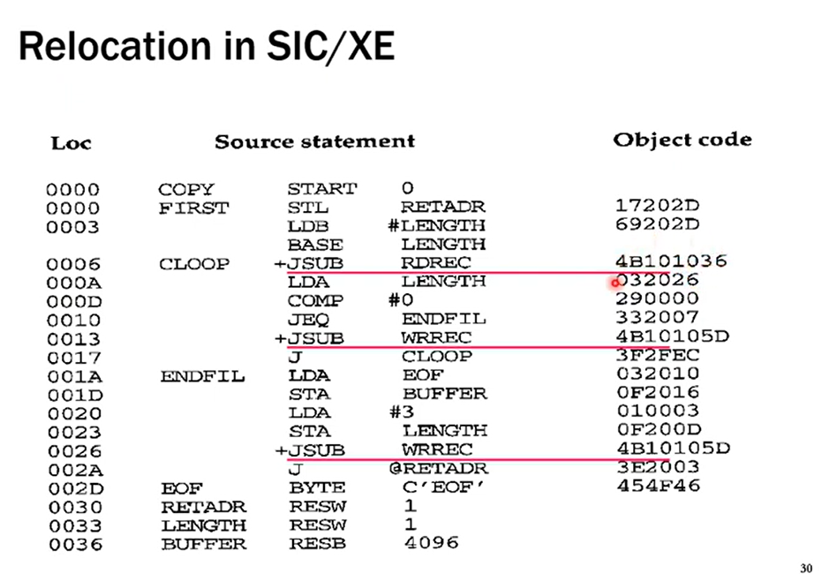

Slide 33
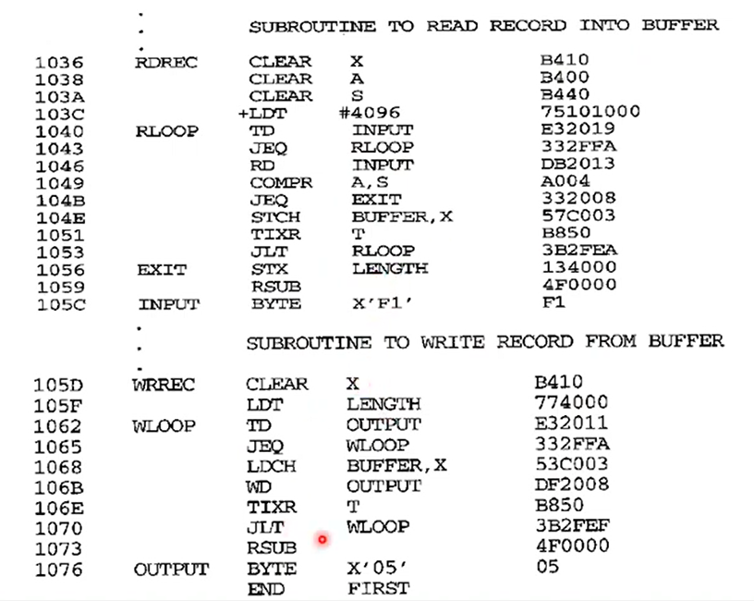

Slide 34
Modification Record
Modification record
col 1: M
col 2-7: relocation address
col 8-9: length (halfbyte)
col 10: flag (+/-)
col 11-17: segment name

Slide 35
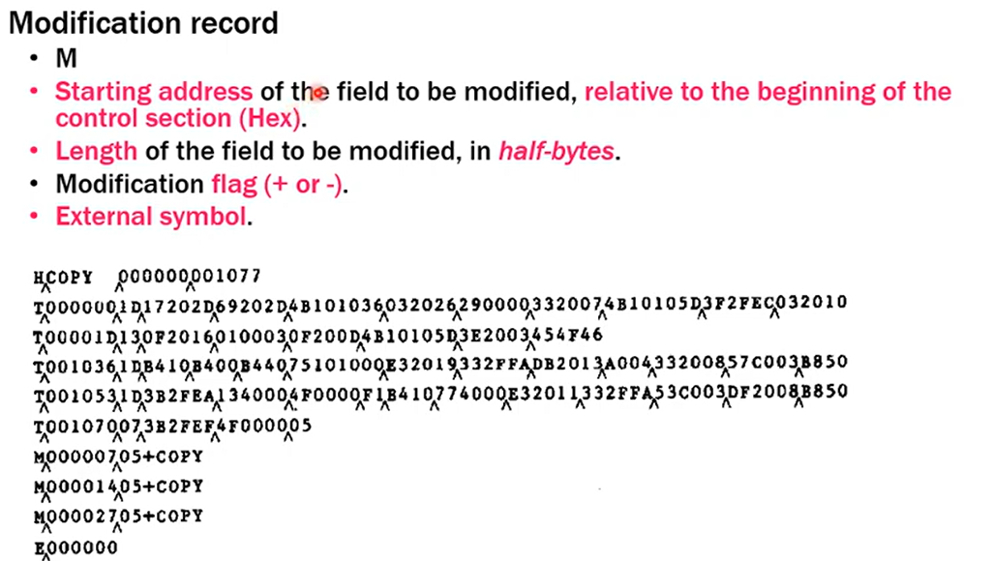

Slide 36
there is modification record for each value that must be changed during relocation- line nos 15,35,65
Each modification record specifies the staring address and length of the field whose value is to be altered
it decribes the modification ie -all the modifications add the value of symbol COPY (starting address of the program )

Slide 37
Modification record scheme is not well suited for use with all machine architecture(Not with SIC)
SIC do not use relative addrssing so address in each instruction must be modified when program is relocated
Require too many modification record and object program size is twice as large

Slide 38
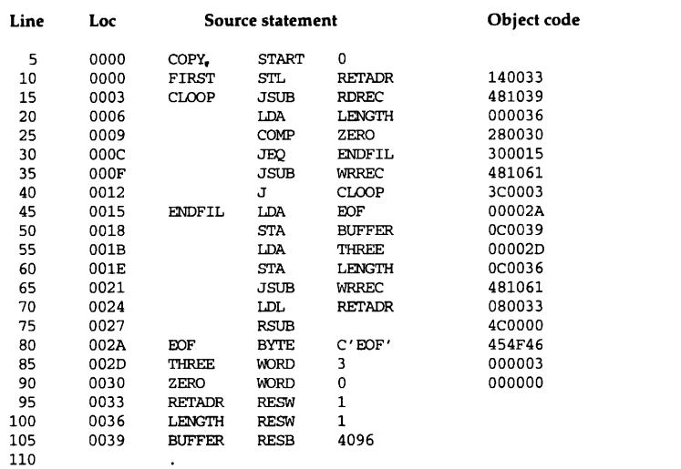

Slide 39
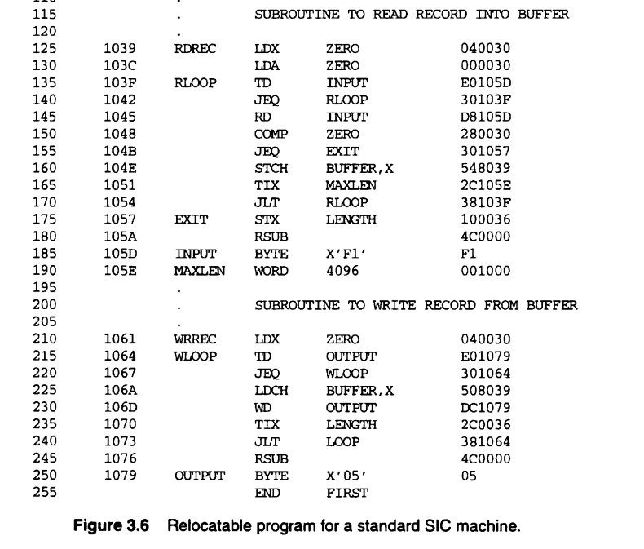

Slide 40
SIC do not use relative addressing
so address in all instructions except RSUB should be modified when program is relocated
This requires 31 modification records-object program twice as large

Slide 41
for machine with direct addressing and fixed instruction format specify relocation using relocation bit
There are no modification records here
text record is same as before except that there is a relocation bit associated with each word of object code
the relocation bit is gathered together into a bit mask following the length indicator in each text record
bit mask is represented as 3 hexadecimal digit

Slide 42
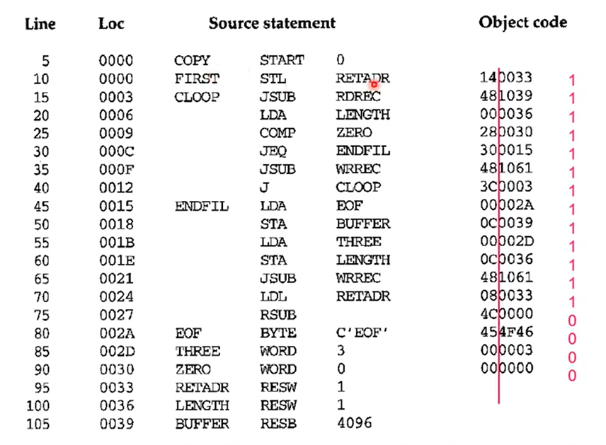
SIC

Slide 43
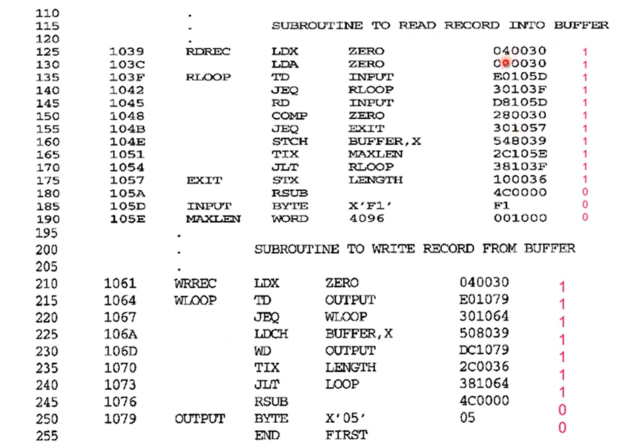

Slide 44
Relocation Bit
Text record
col 1: T
col 2-7: starting address
col 8-9: length (byte)
col 10-12: relocation bits
col 13-72: object code
For simple machines
Relocation bit
0: no modification is necessary
1: modification is needed(starting address need to be added to this word during relocation )
Twelve-bit mask is used in each Text record
if each text record contains less than 12 words of objectcode then bits corresponding to unused words are set to 0
any value that is to be modified during relocation must coincide with one of these 3-byte segments
e.g. line 210

Slide 45
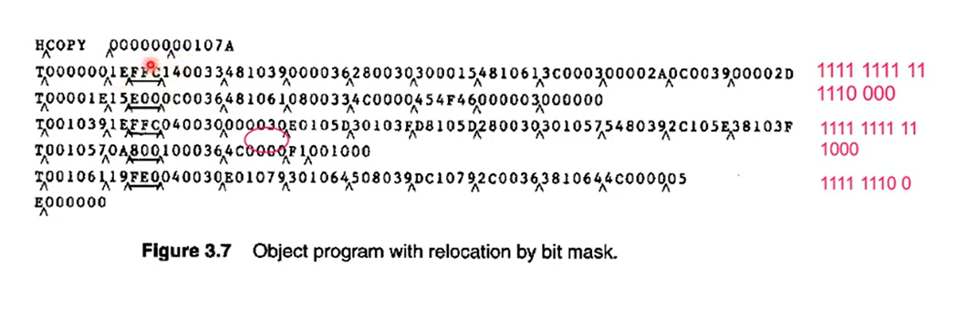

Slide 46
Relocation Bit
Text record
col 1: T
col 2-7: starting address
col 8-9: length (byte)
col 10-12: relocation bits
col 13-72: object code
Bit Mask FFC(1111 1111 11) in the first text record specifies that all 10 words of object code need to be modified during relocation
these words are for instruction from line 10 -55
Bit Mask E00 in second text record specifies that first 3 words are to be modified
Constant do not require modification

Slide 47
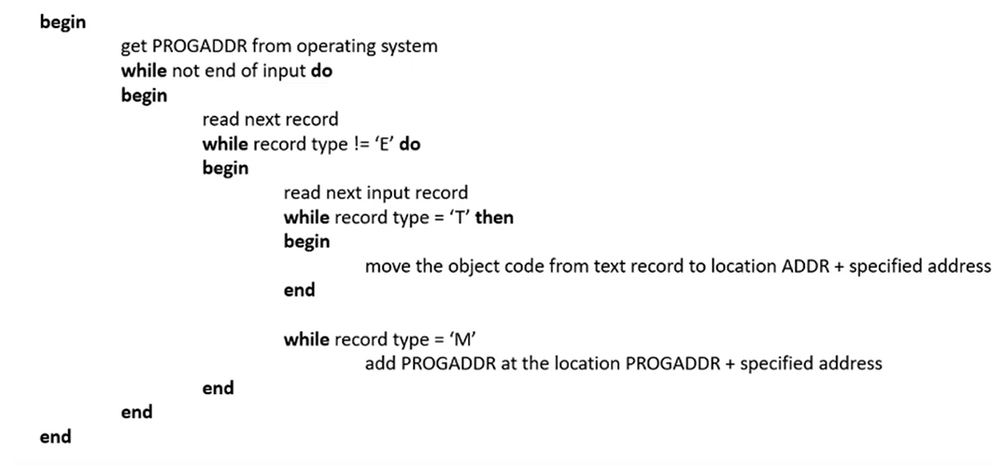
SIC/XE Relocation Algorithm
Starting address obtained from OS=1000(Assume)
Specified address of line no 30=0010
So Instruction will be loaded at 1000+0010=1010

Slide 48
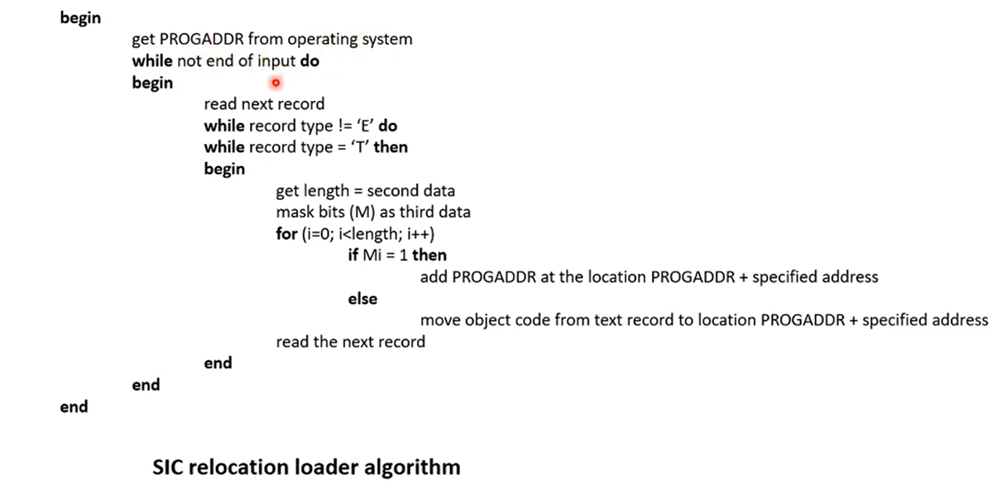

Slide 49
Program Linking
We have seen a program made up of three controls sections assembled together or assembled independently.
they appear as separate segment of code after assembly
loaders point of view -just CS that need to be loaded linked, relocated and dont have to know which CS were assembled at same time
Goal
Resolve the problems with EXTREF and EXTDEF from different control sections

Slide 50
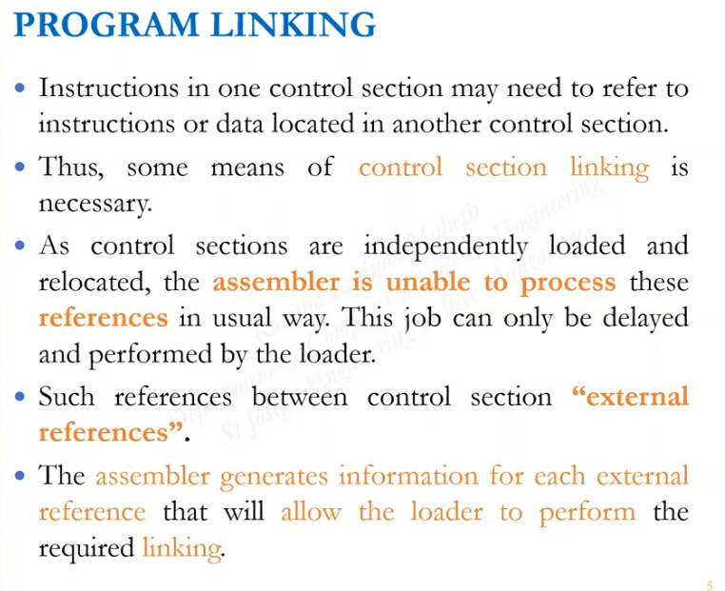

Slide 51
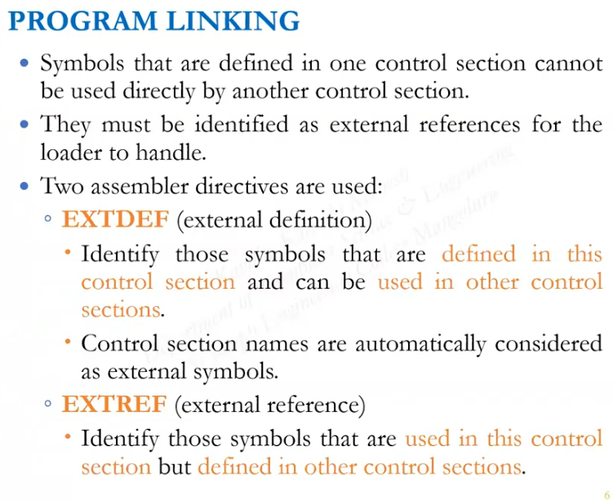

Slide 52
Program Linking
3 separately assembled program each of which consist of single control section.
each program contains a list of items (LISTA,LISTB,LISTC)
end of these list are marked by ENDA,ENDB,ENDC.
labels on the beginning and end of list are external symbols.
each program contains same set of references to external symbols.
3 of these are instruction operands(REF1 through REF3)
Others are the data words(REF4 through REF8)

Slide 53
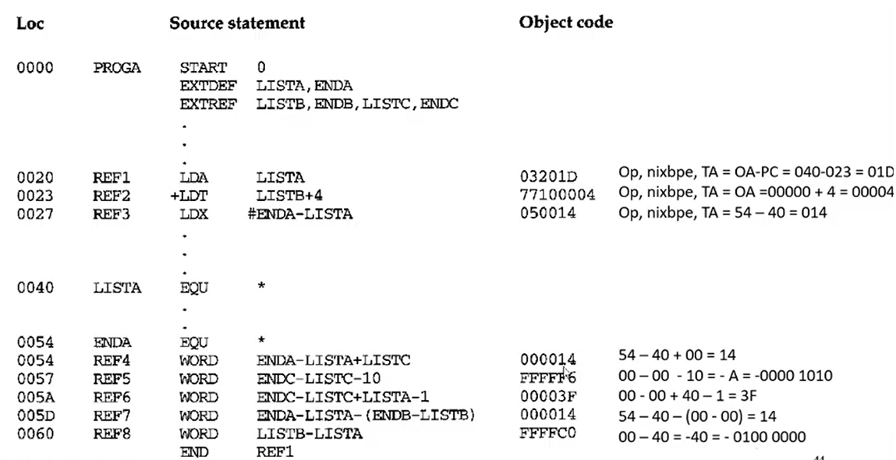

Slide 54
IN PROGA REF1 is reference to label in the program assembled as PC relative instruction
No modification for relocation or linking is necessary.
For REF2 operand expression consist of external reference plus a constant
Assembler stores the value of constant in the address field of the instruction and a modification record directs the loader to add to this field the value of LISTB.
REF3 is an immediate operand whose value is difference between ENDA and LISTA,assembler has all the information needed to compute values

Slide 55
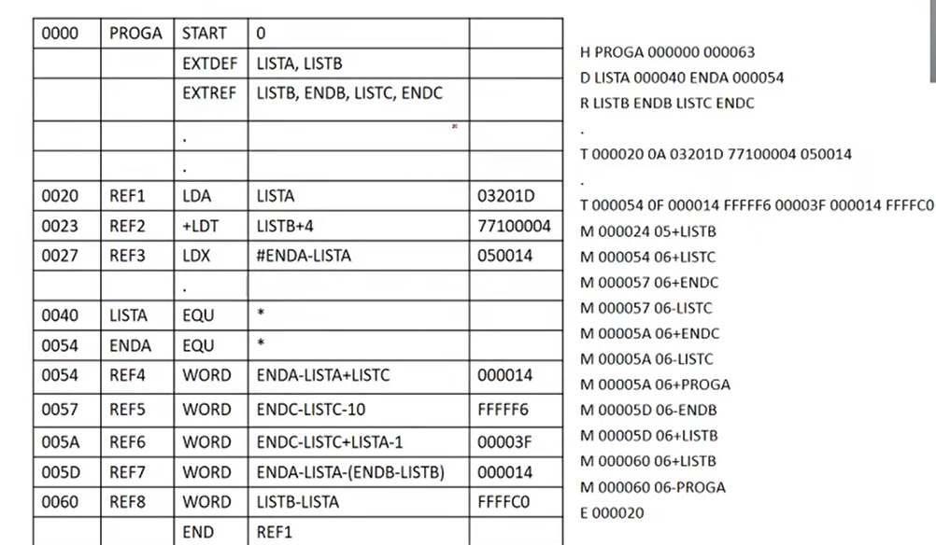
PROGA
ENDA

Slide 56
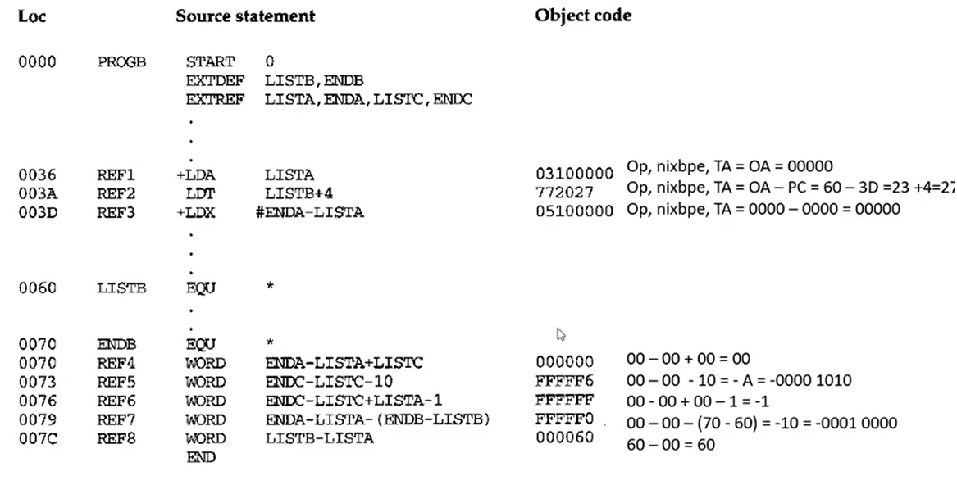

Slide 57
In PROGB REF1 is external symbol
Assembler uses an extended format instruction with address field set to 00000
Object code for PROGB contains modification record instructing the loader to add the value of symbol LISTA to this address field when the program is linked
IN PROGB REF2 is local reference and is assembled using PC relative instruction with no relocation or linking needed
REF3 values of lables is unknown
expression must be assembed as an external reference and final result will be an absolute value independent of location where they are loaded.

Slide 58
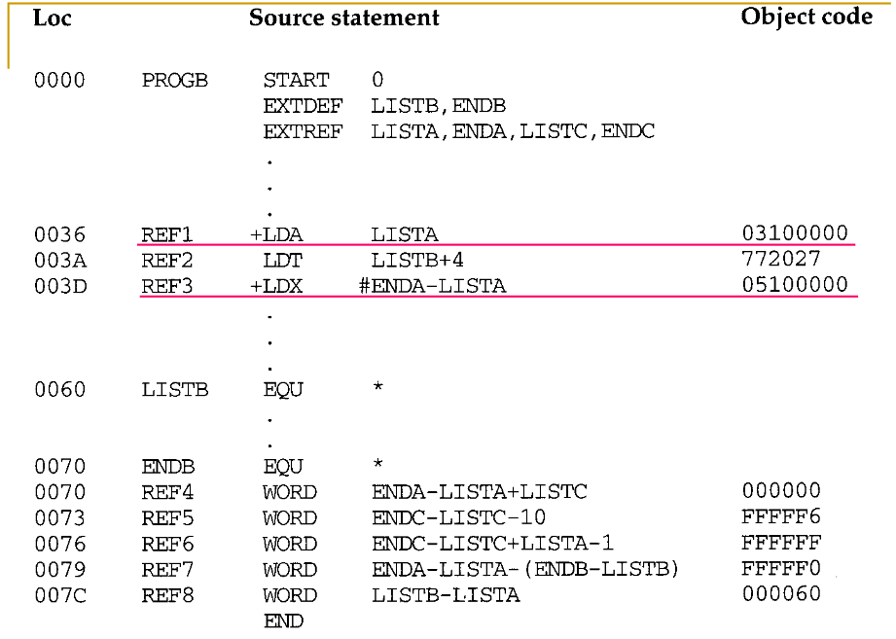
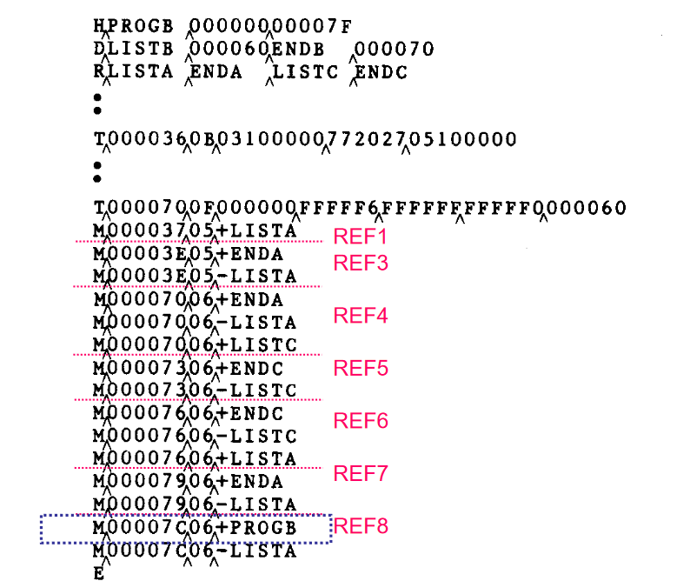

Slide 59
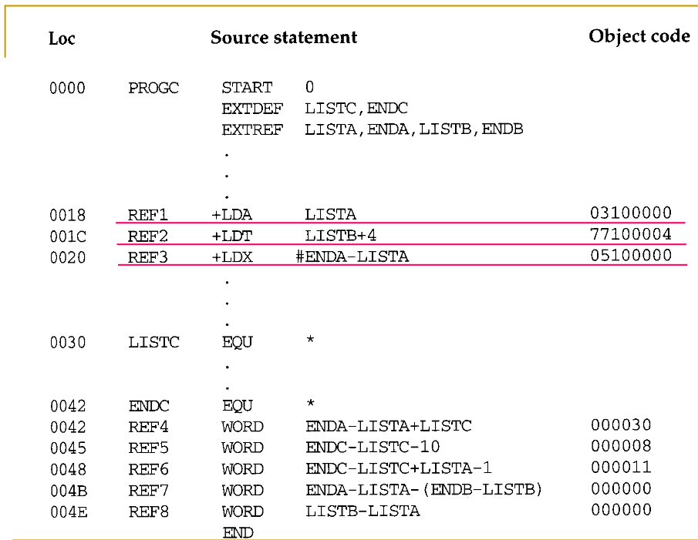
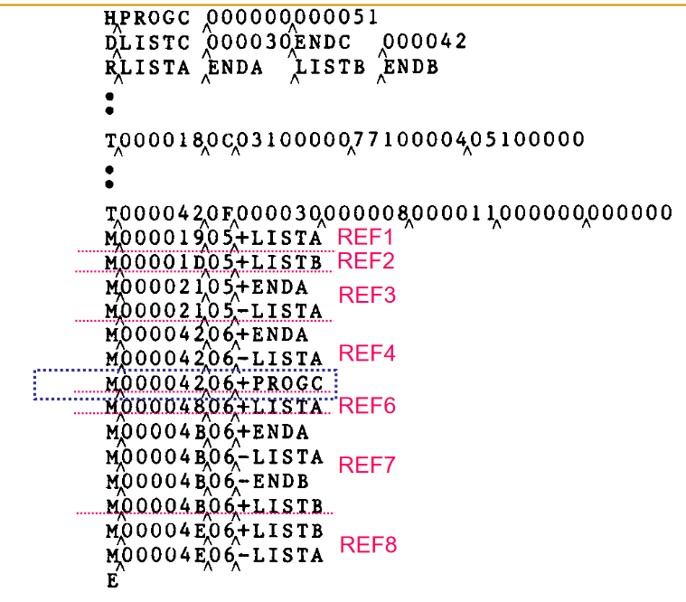

Slide 60
remaining terms passed to loader through modification records
In case of REF4 in PROGA assembler can evaluate all expression except value of LISTC
This result in an initial value of hex 000014 and 1 modification record
same expression in PROGB contains no terms that can be evaluated by assembler
object code therefore contains 000000 and 3 modification record.

Slide 61
In PROGC assembler can supply the value of LISTC
the initial value of this contains relative address of LISTC(hex 000030)
So REF4 is simple external reference for PROGA ,complicated external reference for PROGB and combination of relocation and external reference for PROGC

Slide 62
Program Linking (Linking Loader)
• Many programming languages allow us to write different pieces of code called modules, separately. This simplifies the programming task because we can break a large program into small, more manageable pieces.
Eventually, we need to put all the modules together. Apart from this, a user code often makes references to code and data defined in some "libraries".
•

Slide 63
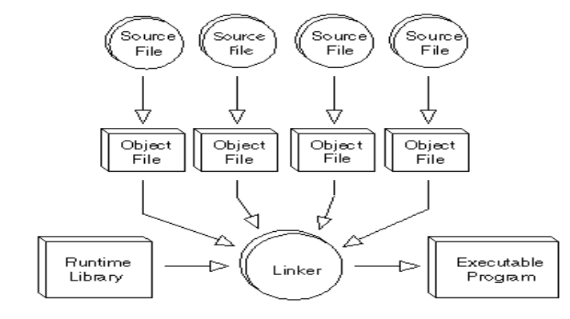

Slide 64
Linking is the process in which references to "externally" defined symbols are processed so as to make them operational.
•A linker or link editor is a program that combines object modules to form an executable program.
• A Linking Loader is a program that has the capability to perform relocation, linking and loading. Linking and relocation is performed at load time

Slide 65
Algorithm and Data Structures for a Linking Loader
• • A linking loader usually makes two passes over its input, just as an assembler does.
• In terms of general function, the two passes of a linking loader are quite similar to the two passes of an assembler:
o Pass 1 assigns addresses to all external symbols.
o Pass 2 performs the actual loading, relocation, and linking.
•

Slide 66
modification record is used for relocation
linking loader mostly used when relative addressing makes relocation unnecessary for most instructions
input for linking loader consist of a set of object programs/control sections that are to be linked together
control section make external reference to symbols whose definition does not appear until later and the required linking opeartion cannot be performed until address is assigned to external symbol

Slide 67
The main data structure needed for linking loader is an external symbol table ESTAB.
This table, which is analogous to SYMTAB in our assembler algorithm, is used to store the name and address of each external symbol in the set of control sections being loaded.
table indicates in which control section the symbol is defined
hashed organization is used

Slide 68
Two other important variables are PROGADDR (program load address) and CSADDR (control section address).
(1) PROGADDR is the beginning address in memory where the linked program is to be loaded.
Its value is supplied to the loader by the OS.
(2) CSADDR contains the starting address assigned to the control section currently being scanned by the loader.
This value is added to all relative addresses within the control section to convert them to actual addresses.

Slide 69
Linking loader PASS 1
• During Pass 1, the loader is concerned only with Header and Define records.
• Variables and Data structures used in PASS1
PROGADDR (Program Load Address) from OS
CSADDR (Control Section Address)
CSLTH (Control Section Length)
ESTAB (External Symbol Table)

Slide 70
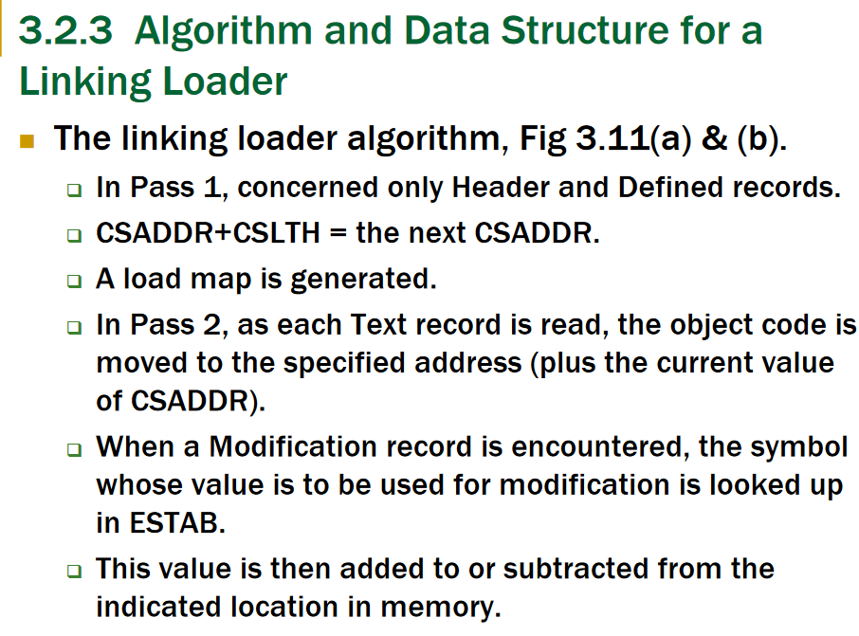

Slide 71
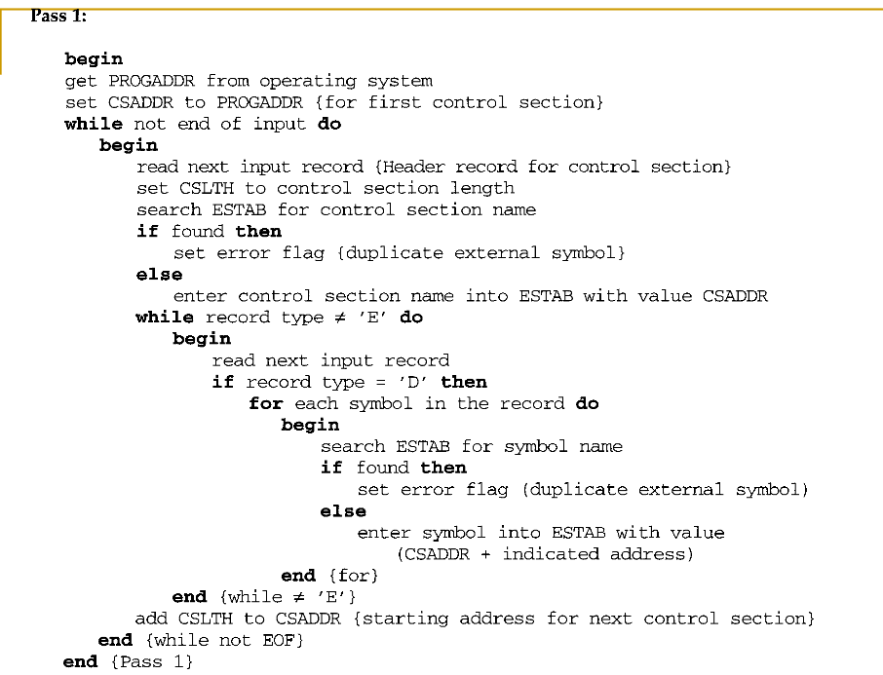

Assume

Slide 72
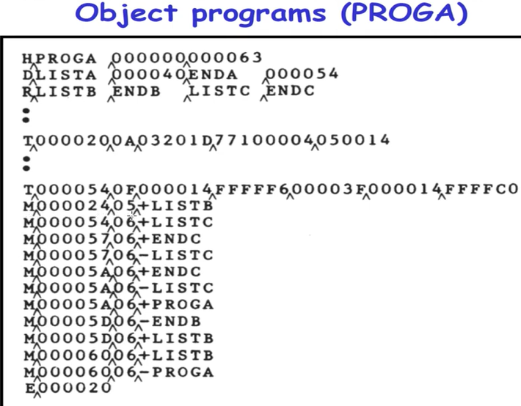
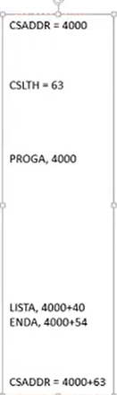
Pass 1 of PROGA

Slide 73
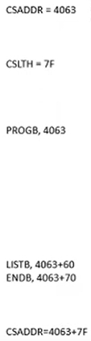
Pass 1 of PROGB

Slide 74
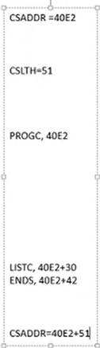
Pass 1 of PROGC

Slide 75
Program Logic and Data Structure
Two Passes Logic
Pass 1: assign addresses to all external symbols
Pass 2: perform the actual loading, relocation, and linking
ESTAB (external symbol table)

Slide 76
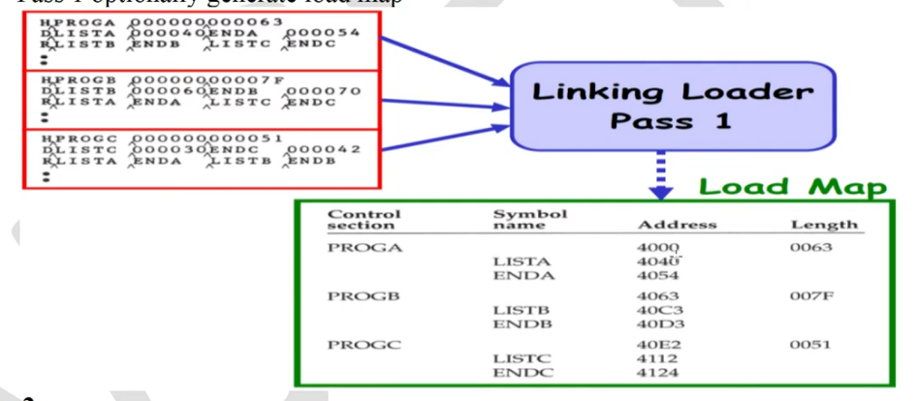

Slide 77
Explanation of Pass 1 algorithm
• The beginning load address for the linked program (PROGADDR) is obtained from the OS.
This becomes the starting address (CSADDR) for the first control section in the input sequence.
• The control section name from Header record is entered into ESTAB, with value given by CSADDR.
• All external symbols appearing in the Define record for the control section are also entered into ESTAB.
Their addresses are obtained by adding the value specified in the Define record to CSADDR.

Slide 78
When the End record is read, the control section length CSLTH (which was saved from the Header record) is added to CSADDR.
This calculation gives the starting address for the next control section in sequence.
At the end of Pass 1, ESTAB contains all external symbols defined in the set of control sections together with the address assigned to each.
option to print a loadmap that shows these symbols and their address.

Slide 79
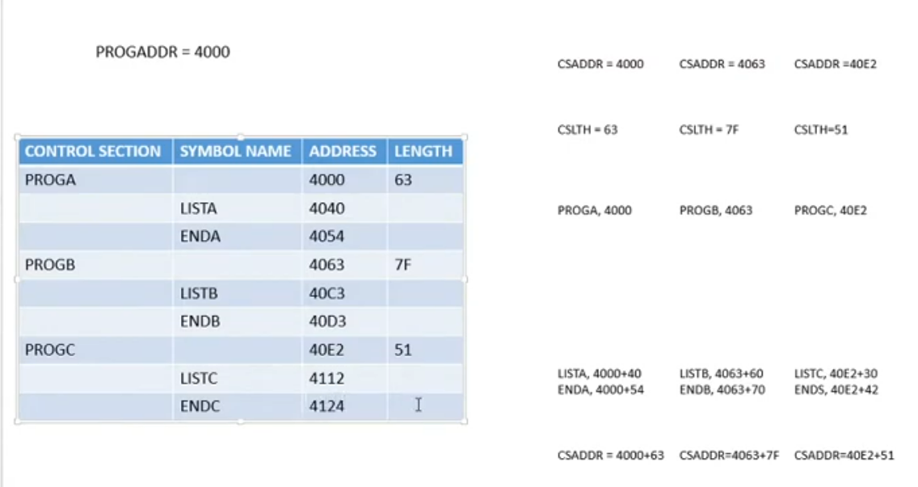
FINAL ESTAB

Slide 80
Linking loader PASS 2
• Pass 2 of linking loader performs the actual loading, relocation, and linking of the program

Slide 81
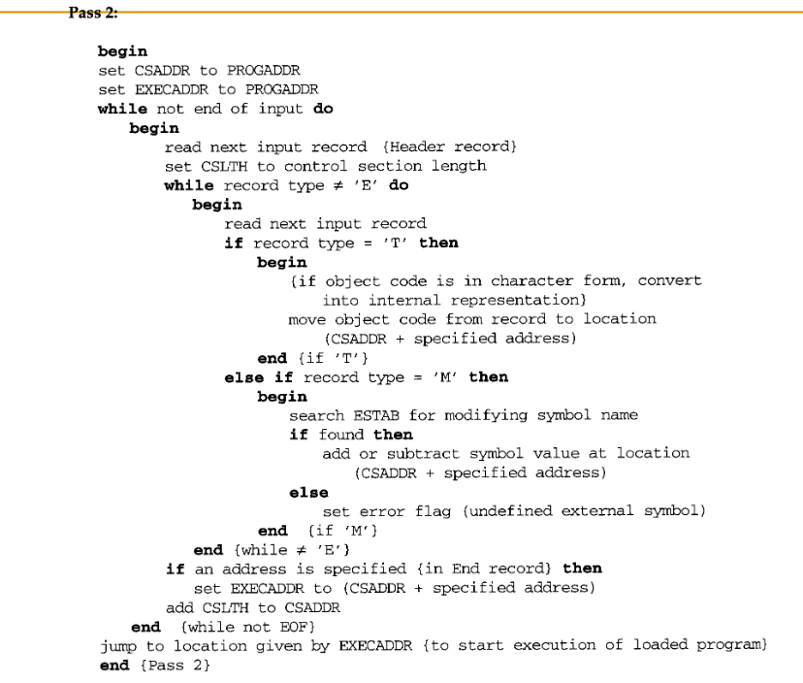
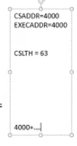

Slide 82
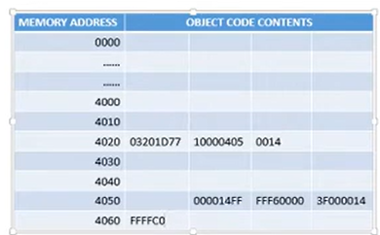
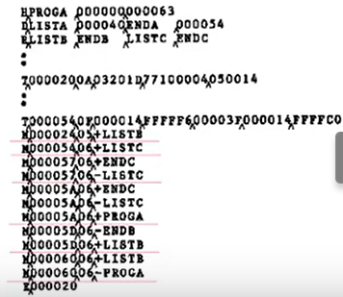
After text records are entered

Slide 83
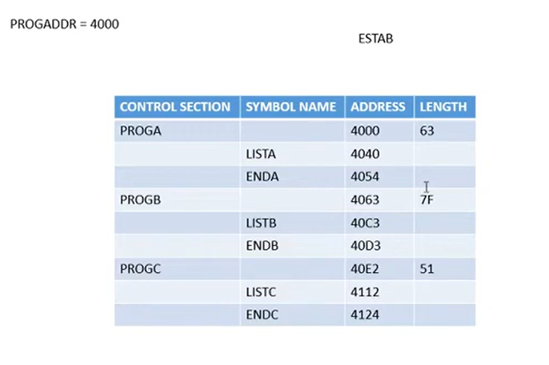

Slide 84
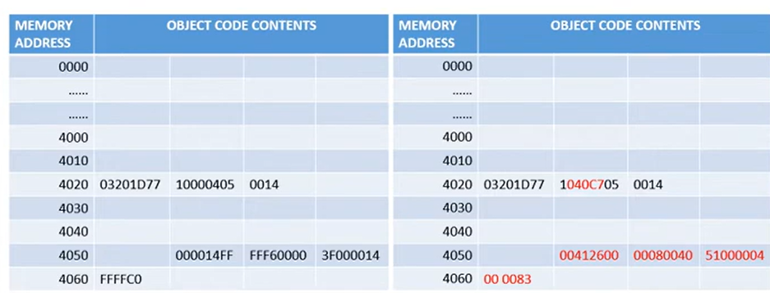
After modification
Before modification

Slide 85
Explanation of Pass 2 Algorithm
• Pass 2 of linking loader performs the actual loading, relocation, and linking of the program
CSADDR contains the actual starting address of the control section currently being loaded
As each Text record is read, the object code is moved to the specified address (plus the current value of CSADDR).
When a Modification record is encountered, the symbol whose value is to be used for modification is looked up in ESTAB.
• This value is then added to or subtracted from the indicated location in memory.
•

Slide 86
The last step performed by the loader is usually the transferring of control to the loaded program to begin execution.
The End record for each control section may contain the address of the first instruction in that control section to be executed.
Loader takes this as the transfer point to begin execution.

Slide 87
Improve Efficiency
Use local searching instead of multiple searches of ESTAB for the same symbol during loading of a control section.
assign a reference number to each external symbol
the reference number is used in Modification records
Implementation
01: control section name
other: external reference symbols

Slide 88
H PROGA 000000 000063
D LISTA 000004 ENDA 000054
R 02 LISTB 03 ENDB
.......
.....
M 000024 05 +02

Slide 89
Figure 3.12
PROGA
PROGB PROGC

Slide 90
Machine independent loader feature -
Automatic library search
Loader options

Slide 91
loader features that are not directly related to machine architecture and design

Slide 92
Automatic library search /Automatic library call
linking loader automatically incorporate/retrieve routines from subprogram library/standard system library into the program being loaded.
this feature allows the programmer to use subroutines from one or more libraries(mathematical/statistical routines) as they were part of programming language
these subroutines called by program being loaded are automatically fetched from the library and linked with the main program and loaded.
Programmer just need to mention subroutine names as external reference in the source program

Slide 93
linking loader that support automatic library search keep track of external symbols that are referred ,not defined.
enter symbols from each Refer record into the ESTAB unless they are already present and are marked as not defined
when definition is encountered the address assigned to the symbol is filled
loader searches the library specified for routines that contain the definition of these symbols and process the subroutines

Slide 94
subroutines fetched from library may themselves contain external refernces
library search process need to be repeated until all references are resolved
if unresolved external reference remain after library search is completed ,they are treated as errors

Slide 95
Programmer can override the standard subroutine in the library by supplying their own routines.eg SQRT
Subroutine with this name would automatically be included through library search function.
A programmer who wanted to use a different version of SQRT could do so simply by including it as input to the loader
Since SQRT will be defined by the end of pass 1 it would not be include in any library search

Slide 96
libraries to be searched by the loader contains assembled or compiled version of subroutines(obj pgm)
Searching the libraries by scanning the Define record might be inefficient
so a special file structure containing directories that gives the name of each routine and a pointer to its address within the file is used for libraries.
if a subroutine is to be called by more than one name,both names are entered in directory

Slide 97
object program is stored once and directory entries points to the same copy of the routine
so library search involves search of the directory and reading the object program
library search process is a resoluton of a call to a subroutine,and resolution of external refernces to data items

Slide 98
loader options
options like specifying alternative input sources
changing /deleting external references
controlling automatic processing of external references
how do you control/manage your loader
many loaders have special command language to specify options ie before object program is passed to loader a set of control statements will be passed to loader for controlling
separate input file to the loader that contains control statements.
control statements may be in the source program and assembler/compiler retains as part of object program

Slide 99
loader options
allows the selection of alternative sources of input based on command language
INCLUDE program-name (library -name)
above comand direct the loader to read the object program from the library and is considered as loader input.
DELETE csect-name
command allows the user to delete external symbols or entire control sections
it may also be possible to change external references within the program being loaded and linked

Slide 100
CHANGE name1,name2
command will cause the external symbol name 1 to be changed to name 2 wherever it appears in the object program.

Slide 101
suppose that the file containg the object program is the primary loader input with the loader commands
INCLUDE READ(UTLIB)
INCLUDE WRITE(UTLIB)
DELETE RDREC,WRREC
CHANGE RDREC,READ
CHANGE WRREC,WRITE

Slide 102
Commands will direct the loader to include control sections READ and WRITE from std library UTLIB
To delete the control sections RDREC and WRREC from the load
First CHANGE command would cause all external reference to symbol RDREC to be changed to refer to symbol READ
References to WRREC would be changed to WRITE
Result is like source program for COPY changed to READ and WRITE

Slide 103
Another loader options is inclusion of library routines to satisfy external references
loader allows the user to specify alternative libraries to be searched using statement
LIBRARY MYLIB
user specified libraries are normally searched before the standard system libraries

Slide 104
programmer can perform analysis of data using routines STDDEV,PLOT,CORREL from statistical library
Analysis done at execution time
if statistical analysis need not be done in a particular execution of the program user could include a command like
NOCALL STDDEV,PLOT,CORREL
this avoids the overhead of loading and linking the unneeded routines and saves the memory space

Slide 105
Option to specify output from loader
Control statement can be used to specify whether or not load map need to be printed
If to be printed ,level of detail can be selected
Other options like location of execution ,loader attempting to excute programs if error detected during load

Slide 106
Loader Design Option
Linking Loader
Linkage Editor
Dynamic Linking

Slide 107
Linking loaders perform all linking and relocation at load time.
There are two alternatives:
Linkage editors, which perform linking prior to load time
Dynamic linking, in which the linking function is performed at execution time.

Slide 108
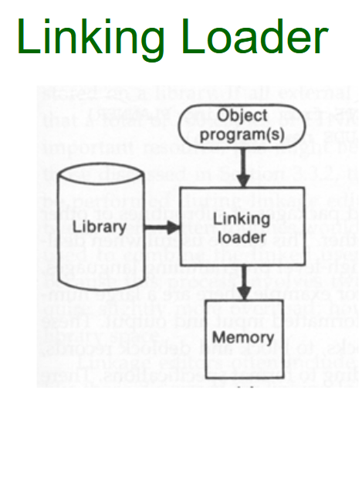

Difference between linkage editor and linking loader
Processing of an object program using a) linking loader b)linkage editor
Linkage Editor

Slide 109
Source program is first assembled or compiled producing an object program
linking loader performs all linking and relocation operations including automatic library search and loads the linked program direclty into memory for execution
linking loader searches libraries and resolve external reference everytime program is executed
when a program is used infrequently storing its assembled version is not worth so using linking loader avoids the steps of reading and writing the linked program

Slide 110
The Linkage Editor(LE) performs relocation of all control sections relative to the start of the linked program.
all items that need to be modified at load time have values that are relative to the start of the linked program.
If the actual address at which the program will be loaded is known in advance linkage editor can perform all of the needed relocation
So loading can be accomplished in one pass with no external symbol table
If a program is to be executed many times without being reassembled, the use of a linkage editor substantially reduces the overhead required.
Resolution of external reference and library searching are only performed once for linkage editor.

Slide 111
Linked program produced by LE is in a form that can be processed by relocation loader.
linked program that is an exact image of the way the program will appear in memory during execution
linkage editor produces a linked version of the program(load module /executable image )which is written to file /library for later execution
All external references are resolved ,relocation is indicated by modification record/bit mask
Information concerning external references will be retained in the linked program for reprocessing by LE else only loading and execution only can be done

Slide 112
Consider a program PLANNER with a number of subroutines.
You want to improve a subroutine (PROJECT) of the program (PLANNER) for some error correction /incre efficiency
For that you can use linkage editor commands as follows:
INCLUDE PLANNER (PROGLIB)
DELETE PROJECT // d e l e t e from e x i s t i n g PLANNER
INCLUDE PROJECT (NEWLIB) // includ e new v e r s i o n
REPLACE PLANNER (PROGLIB)

Slide 113
Dynamic Linking/Dynamic Loading/Load-on-call
• Linkage editors perform linking operations before the program is loaded for execution.
• Linking loaders perform these same operations at load time.
• Dynamic linking, dynamic loading, or load on call postpones the linking function until execution time. That is a subroutine is loaded and linked to the rest of the program when it is first called.
•

Slide 114
Dynamic linking is often used to allow several executing programs to share one copy of a subroutine or library (eg. run-time support routines for a high-level language like C.)
Dynamic linking also allows objects(software) to be shared by several program

Slide 115
Dynamic linking allows to load the routines only when they are needed (when subroutines-large,many external refernce)
For example, that a program contains subroutines that correct or clearly diagnose error in the input data during execution.
If such error are rare, the correction and diagnostic routines may not be used at all during most execution of the program.
if the program were completely linked before execution, these subroutines need to be loaded and linked every time.

Slide 116
With a program that allows its user to interactively call any of the subroutines of a large mathematical and statistical library, all of the library subroutines could potentially be needed, but only a few will actually be used in any one execution.
Dynamic linking can avoid the necessity of loading the entire library for each execution except those necessary subroutines.

Slide 117

Loading and calling of a subroutine using dynamic linking
Fig illustrates a method in which routines that are to be dynamically loaded must be called via an OS service request.

Slide 118


Slide 119
Fig (a): Whenever the user program needs a subroutine for its execution, the program makes a load-and-call service request to OS
The parameter of this request is the symbolic name(ERRHANDL) of the routine to be called.
Fig (b): OS examines its internal tables to determine whether or not the routine is already loaded.
If necessary, the routine is loaded from the specified user or system libraries.
•

Slide 120
Fig (c): Control is then passed from OS to the routine being called.
Fig (d): When the called subroutine completes it processing, it returns to its caller (i.e., OS).
OS then returns control to the program that issued the request.
Fig (e): If a subroutine is still in memory, a second call to it may not require another load operation. Control may simply be passed from the dynamic loader to the called routine

Slide 121
Module-5
(Macro Preprocessor, Device drivers, Text Editors, Debuggers)
21/10/2024

Slide 122
Contents
Macro Preprocessor- Macro Instruction Definition and Expansion
One pass Macro processor algorithm and data structures and illustration with example
Machine Independent Macro Processor Features- generation of unique labels,
Concatenation of macro parameter,
Keyword macro parameters
Conditional Macro Expansion
Macro processor design options

Slide 123
Contents
Device drivers-
Anatomy of a device driver,
Character and block device drivers,
General design of device drivers
Text Editors-
Overview of Editing,
User Interface ,
Editor Structure
Debuggers -
Debugging Functions and Capabilities,
Debugging Methods- By Induction, Deduction and Backtracking.

Slide 124
Macro Preprocessor-
Macro Instruction Definition and Expansion

Slide 125
Macro instruction(Macro)
A Macro commmonly used group of statements in the source programming language
Macro processor replaces each macro instruction with the corresponding group of source language statement -Expanding Macros

Slide 126
Macro Definition and Expansion
program uses 2 macro instructions RDBUFF and WRBUFF
Definition of Macro starts after START statement
2 Assembler directives-MACRO and MEND are used in macro definition.
first MACRO(line 10) identifies beginning of macro definition
symbol in the label field (RDBUFF)is the name of the macro
entries in the operand field identifies the parameters of macro instruction.

Slide 127
each parameter begins with the character & which facilitates the substitution of parameters during expansion
macro name and parameter define pattern/prototype for the macro instruction
following the macro directive are the statements that make up the body of macro definition(line 15-line 90)-statements that will be generated as macro is expanded
MEND assembler directive indicate end of macro definition-line no 95

Slide 128
Main program start on line no 180
line 190 is macro invocation statement
Macro invocation statement gives the name of the macro instruction being invoked and the arguments to be used in expanding the macro
macro invocation statemnt is also called macro call

Slide 129
In the output
Macro instruction definitions have been deleted since they are no longer needed after the macros are expanded
Each macro invocation statement have been expanded into the statement that form the bodyof the macro with the arguments from the macro invocation substituted for the parameters in the macro prototype
Arguments and parameters are associated with one another according to their positions(ie first argument in macro invocation correspond to first parameter in macro prototype...)

Slide 130
For example
In expanding macro inocation in line no 190 argument F1 is substituted for parameter &INDEV wherever it occurs in the body of the macro
BUFFER is substituted for &BUFADR
LENGTH is substituted for &RECLTH
Lines 190a to 190m shows complete expansion of the macroinvocation on line 190
2 invocation of WRBUFF specify different arguments so they produce different expansions

Slide 131


Slide 132


Slide 133


Slide 134

MACRO INVOCATION

Slide 135

MACRO EXPANSION

Slide 136
Difference between Macro and Subroutine
Macros differ from subroutines in two fundamental aspects:
A macro call leads to its expansion, whereas subroutine call leads to its execution.
So there is difference in size and execution efficiency.
Statements of the macro body are expanded each time the macro is invoked.
statements of the subroutine appear only once, regardless of how many times the subroutine is called

Slide 137


Slide 138
Macro processor algorithm and data structure
It is easy to design a two-pass macro processor in which all macro definitions are processed during the first pass and all macro invocation statements are expanded during second pass.
Such a two pass macro processor cannot handle nested macro definitions.
Nested macros are macros in which definition of one macro contains definition of other macros.
•

Slide 139

Consider the macro definition example given below, which is used to swap two numbers.
The macro named SWAP defines another macro named STORE inside it.
These type of macro are called nested macros.
Because all macros have to be defined during the first pass before any macro invocation were expanded

Slide 140
All macros would have to be defined during the first pass before any macro invocation were expanded
Defining a macro does not define its submacro or other macro instructions
Definitions are processed only when invocation of macro is expanded
so 1 pass macro processor that can alternate between macro definition and macro expansion is able to handle nested macros
Because of one pass structure definition of macro must appear in the source program before any statement that invoke that macro

Slide 141
One-Pass Macro Processor:
• A one-pass macro processor that alternate between macro definition and macro expansion in a recursive way is able to handle recursive macro definition.
• Restriction
o The definition of a macro must appear in the source program before any statements that invoke that macro.
o This restriction does not create any real inconvenience.

Slide 142

One pass Macro processor algorithm and data structures and illustration with example

Slide 143


Slide 144


Slide 145


Slide 146


Slide 147
Data Structures involved in the design of one pass macro processor
There are 3 main data structures involved in the design of one pass macro processor:
DEFTAB
macro definitions are stored in definition table which contains the macro prototype and the statements that make up the macro body
comment lines from the macro definition are not entered in DEFTAB because they are not part of macro expansion.
References to the macro instruction parameters are converted to a positional notation for efficiency in substituting arguments

Slide 148
NAMTAB
Macro names are entered in NAMTAB which serve as an index to DEFTAB
For each macro instruction defined NAMTAB contains pointers to the beginning and end of the DEFTAB

Slide 149
ARGTAB
Argument table is used during expansion of macro invocations
when the macro invocation statement is recognized arguments are stored in ARGTAB according to their position in argument list
As the macro is expanded the arguments from ARGTAB are substituted for the corresponding parameter in the macro body

Slide 150


Slide 151
Definition of RDBUFF stored in DEFTAB with an entry in NAMTAB identifying the begining and end of definition
positional notation have been used for parameters
prarameter &INDEV have been converted to ?1(indicating first parameter in the prototype)
&BUFADR has been converted to ?2
Argument table shows contents during expansion of RDBUFF statement on line 190 where first argument is F1,second is BUFFER..
when ?n is recognized in a line from DEFTAB a simple indexing operation supplies proper argument from ARGTAB

Slide 152
Procedure DEFINE is called when the beginning of a macro definition is recognized makes entries in DEFTAB and NAMTAB
Procedure EXPAND is called to set up the argument values in ARGTAB and expand a macro invocation statement.
Procedure GETLINE which is called at several points in the algorithm gets the next line to be processed which may come from DEFTAB,or from input file depending on whether the boolean variable EXPANDING is TRUE or FALSE

Slide 153


Slide 154


Slide 155


Slide 156


Slide 157


Slide 158


Slide 159


Slide 160


Slide 161


Slide 162


Slide 163


Slide 164

Handling of macro definition within macro

Slide 165

MEND on line -3 which is actually end of RDBUFF would be taken as end of MACROX definition
To solve this DEFINE procedure maintains a counter named LEVEL

Slide 166
Machine Independent Macro Processor Features-
generation of unique labels,
Concatenation of macro parameter,
Keyword macro parameters
Conditional Macro Expansion

Slide 167
Concatenation of macro parameter
Most macro processor allows parameters to be concatenated with other character strings.
Suppose that a program contains a series of variables named by the symbols XA1, XA2, XA3,…, another series of variables named XB1, XB2, XB3,…, etc.
If similar processing is to be performed on each series of labels, the programmer might put this as a macro instruction.
The parameter to such a macro instruction could specify the series of variables to be operated on (A, B, etc.).
The macro processor would use this parameter to construct the symbols required in the macro expansion (XA1, XB1, etc.).

Slide 168
Suppose that the parameter to such a macro instruction is named &ID.
The body of the macro definition might contain a statement like LDA X&ID1
parameter &ID is concatenated after the character string X and before the character string 1
beginning of macro parameter is identified by starting symbol &
end of parameter is not marked.
statement can also mean charcter string X followed by parameter &ID1
if macro definition contains both &ID and &ID1 as parameters would be ambigous

Slide 169
Most of the macro processors deal with this problem by providing a special concatenation operator.
Thus the statement LDA X&ID1 can be written as
LDA X&ID 1
macro processor deletes all occurences of concatenation operator immediately after performing parameter substitiution and character will not appear in macro expansion

Slide 170


The statement SUM A and SUM BETA shows the invocation
statements and the corresponding macro expansion

Slide 171
Generation of Unique Labels
it is not possible to use labels for the instructions in the macro definition, since every expansion of macro would include the label repeatedly which is not allowed by the assembler.
In the definition of WRBUFF if a label were placed on the TD instructions on line no 135 this label would be defined twice -once for each invocation of WRBUFF
This duplicate definition would prevent correct assembly of the resulting expanded program

Slide 172


Slide 173

Example

Slide 174

Problem

Slide 175
Solution
To use relative addressing in the jump instructions which is acceptable for short jumps such as JEQ
for longer jumps spanning several instructions such notations will be causing error .

Slide 176

Solution :Macro expansion using relative addressing

Slide 177


Slide 178
solution 2
Instead we can use the technique of generating unique labels for every
macro invocation and expansion.
labels used within the macro body begin with a special character $
each symbol beginning with $ has been modified by replacing $ with $AA
generally character $ will be replaced by $xx ,where xx is a two character alphanumeric counter of the number of macro instructions expanded.
for the first macro expansion in a program xx will be AA for succeeding macro expansion xx will be set to AB,AC...
For example,
XX = AA, AB, AC…
2 character counter allows 1296 macro expansions in a single program.

Slide 179


Slide 180


Slide 181



Slide 182



Slide 183
Keyword macro parameter
All the macro instruction definitions used positional parameters.
Parameters and arguments are matched according to their positions in the macro prototype and the macro invocation statement.
The programmer needs to be careful while specifying the arguments in the proper order.
Positional parameters are suitable for the macro invocation.

Slide 184
Macro defintition
STRG MACRO &A1 ,&A2, &A3
STA &A1
STB &A2
STX &A3
MEND
Macro call
STRG DATA1,DATA2,DATA3

Slide 185
Keyword macro parameter
Positional Parameter
Keyword parameter
Default specification of parameter

Slide 186
If an argument is to be omitted the macro invocation statement must contain a null argument mentioned with two consecutive commas to maintain correct argument positions.
Eg : RDBUFF 0E, BUFF,LENGTH, , 80
MOVE STR , , 10

Slide 187
Keyword macro parameter
if the macro invocation has large number of parameters, and if only few of these are given values in a typical invocation, a different type of parameter specification is required
Keyword parameters
Each argument value is written with a keyword that names the corresponding parameter.
Arguments may appear in any order.
Null arguments no longer need to be used.
E.g.
GENERTYPE=DIRECT, CHANNEL=3
It is easier to read and much less error-prone than the
positional method.

Slide 188
Macro defintition
STRG MACRO &A1= ,&A2=, &A3=
STA &A1
STB &A2
STX &A3
MEND
Macro call
STRG &A1=DATA1, &A3=DATA2, &A2=DATA3

Slide 189
Default specification of parameters
Macro defintition
STRG MACRO &A1= ,&A2=, &A3=DATA 3 default value
STA &A1
STB &A2
STX &A3
MEND
Macro call
STRG &A1=DATA1, &A2=DATA2,
This specification is useful in situations where a parameter has the same value in most calls.
When the desired value is different from the default value, the desired value can be specified explicitly in a macro call.

Slide 190


Slide 191


Slide 192


Slide 193
Conditional Macro Expansion
Macro-time conditional statements
Macro processor directives:
IF-ELSE-ENDIF
SET
Macro time variable
- Any symbols that begin with the character & and that is not a macro instruction parameter is assumed to be a macro-time variable.
- All such variables are initialized to a value as 0.
SET is a macro processor directive.
&EORCK is a macro-time variable that is used to store working values during macro expansion.
&EORCK SET 1

Slide 194


Slide 195


Slide 196


Slide 197


Slide 198


Slide 199
Most macro processors can modify the sequence of statements generated for a macro expansion,depending on the arguments supplied in the macro invocation.
For example
The definition of the macro RDBUFF has two additional parameters:
- &EOR: Specify a hexadecimal character code that marks the end of a record.
- &MAXLTH: Specify the maximum length record that can be read.
Testing of boolean expression in IF statement occurs at the time macros are expanded
By the time program is assembled all such decisions have been made

Slide 200
Macro -time looping statement
WHILE ENDW
Macro processor functions
%NITEMS:THE NUMBER OF MEMBERS IN AN ARGUMENT LIST
Eg:&EOR=(00,03,04)
=%NITEMS(&EOR) is 3

Slide 201


Slide 202
Macro processor design options
Recursive macro expansion
General-purpose macro processors
Macro processing within language translators

Slide 203

Recursive macro expansion
Invocation of one macro by another macro is called recursive macro
Here the macro named INPUT is calling another macro named SUM. This is called as recursive macro.

Slide 204


Slide 205


Slide 206

The macro processor design algorithm discussed previously cannot handle recursive macro invocation and expansion.
The algorithm does not work properly if the macro invocation statement appears within the body of a macro instruction
The procedure EXPAND would be called when the macro was recognized .
The arguments from the macro invocation would be entered into ARGTAB as

Slide 207
• Reasons
The boolean variable EXPANDING would be set to TRUE and expansion of macro invocation statement would begin
The processing proceed until line 50 which contains a statement invoking RDCHAR
PROCESSLINE would call EXPAND again
Parameter | Value
1 | F1
2 | ...
 | ...

Slide 208
The expansion of RDCHAR will proceed normally.
At the end of definition of RDCHAR was recognized the Boolean variable EXPANDING would be set to FALSE
when the “inner” macro expansion is finished, that is, the macro process would forget that it had been in the middle of expanding an “outer” macro.
Arguments from original macro invocation RDBUFF would be lost because the values in ARGTAB were overwritten with arguments from the invocation of RDCHAR
These difficulties are due to recursive call of the procedure EXPAND
A similar problem would occur with PROCESSLINE since this procedure too would be called recursively.

Slide 209
Solutions:
Write the macro processor in a programming language that allows recursive calls, thus local variables will be retained.
Compiler would be sure that previous values of any variables declared within the procedure were saved when that procedure was recursively called
Details regarding returning from procedure should also be taken care of
If we are writing in a language without recursion support, use a stack to take care of pushing and popping local variables and return addresses. So the recursive calls can be handled.
Procedures PROCESSLINE and EXPAND would not be used and the sam e logic can be incorporated into looping structure

Slide 210
General-Purpose Macro Processors
The macro processor we discussed so far is related to assembly language programming.
Macro processor for high level languages have also been developed.
Macro processors which are designed for a specific language are called special purpose macro processors.
Example for special purpose macro processor is MASM Macro processor
These special purpose macro processors are similar in general function and approach but the implementation details differ from language to language
The general purpose macro processor do not dependent on any particular programming language, but can be used with a variety of different languages.
Example for a general purpose macro processor is ELENA Macro processor

Slide 211
Advantages
Programmers do not need to learn many macro languages, so much of the time and expense involved in training are eliminated.
Although its development costs are somewhat greater than those for a specific language macro processor, this expense does not need to be repeated for each language, thus save substantial overall cost, similar in case of maintenance also

Slide 212
Disadvantages
In spite of the advantages noted, there are still relatively few general purpose macro processors.
The reasons are:
• Large number of details must be dealt with in a real programming language.
• There are several situations in which normal macro parameter substitution or normal macro expansion should not occur
For example, comments are usually ignored by the macro processor.
But each programming languages uses its own method for specifying comments.
So a general purpose macro processor should be designed with the capability for identifying the comments in any programming languages.

Slide 213
Another problem is with the facilities for grouping together terms, expressions, or statements.
Some languages use keywords such as begin and end for grouping statements
while some other languages uses special characters like { }.
A general purpose macro processor may need to take these groupings into account in scanning the source statements.
Another problem is with the identification of tokens of the programming languages. The tokens means the identifiers, constants, operators and keywords in the programming language.
Different languages uses different rules for the formation of tokens. So the
design of a general purpose macro processor must take this into consideration.
Another problem is with the syntax used for macro definitions and macro invocation statements

Slide 214
Macro Processing within Language Translators
Macros can be processed
1. Outside the language translators
2. Within the Language translators
1.Macro processing outside the language translators
The macro processors that we had discussed so far belongs to this group. They are called macro preprocessors.
They reads the source program statements, process the macro definitions and expand macro invocations, producing an expanded version of the source program.
This expanded program is then used as input to an assembler or compiler.
So this can be considered as macro processing outside the language translators

Slide 215
2.Macro processing within the language translators
methods for combining the macro processing functions with the language translator itself.
Two common methods are
a) Line –by- Line Macro Processors
b) Integrated Macro Processors

Slide 216
Line-by-line macro processor
• The simplest method for combining the macro processing functions with the
language translator is a line-by-line approach.
• Using this approach, the macro processor reads the source program statement, process the macro definitions and expand macro invocations. But it does not produce an expanded version of source program.
• The processed lines are passed to the language translator(compiler or assembler) as they are generated one at a time , instead of being written to an expanded source file.
• Thus macro processor operates as a sort of input routine for the assembler or
compiler.

Slide 217
Benefits of line –by-line macro processor
It avoids making an extra pass over the source program(writing and then reading the expanded file). So it can be more efficient than using a macro preprocessor
Some of the data structures required by the macro processor and the language
translator can be combined (e.g., OPTAB in assembler and NAMTAB in macro processor )
Many utility subroutines can be used by both macro processor and the language translator.
This involves scanning input lines, searching tables , converting numeric
values to internal representation etc.
It is easier to give diagnostic messages related to the source statements.

Slide 218
Integrated Macro Processors
• Although a line-by-line macro processor may use some of the same utility routines as
language translator, the functions of macro processing and program translation are
still relatively independent.
• It is possible to have even closer cooperation between the macro processor and the
language translator. Such a scheme is called as language translator with an integrated
macro processor.
• An integrated macro processor can potentially make use of any information about
the source program that is extracted by the language translator.
• The macro processor may use the results of the translator operations such as scanning
of symbols, constants, etc without involved in processing it.
•

Slide 219
For example in FORTRAN language, consider the statement:
DO 100 I = 1,20
where DO is a keyword, 100 is statement number, I is a variable name etc.
DO 100 I = 1
since in FORTRAN blanks are not significant, this statement is an assignment
that gives the value 1 to the variable DO100I.
Thus the proper interpretation of characters DO, 100.. cannot be decided until the rest of the statement is examined.

Slide 220
Disadvantages of line-by-line and integrated macro processors
They must be specially designed and written to work with a particular implementation of an assembler or compiler.
The cost of macro processor development is added to the costs of the language translator, which results in a more expensive software.
The assembler or compiler will be considerably larger and more complex than using a macro preprocessor.
Size may be a problem if the translator is to run on a computer with limited memory.

